Slide 1


ITEC614 Introduction to Cyber Security
Dr. Farshid Keivanian
Lecturer, Information Technology, PFBS

Slide 2
Becoming a CS Specialist
Lecture 9

Slide 3
Previous Lecture…
Have studied…
Defending systems & devices
Server hardening
Network hardening
Physical security
Remote computing security

Slide 4
Today’s Objectives
Cybersecurity Domains
Describe resources available to students interested in pursuing a career in cybersecurity.
Understanding the Ethics of Working in Cybersecurity
Explain how ethics provide guidance.
Next Step
Explain how to take the next step to become a cybersecurity professional.

Slide 5
References
This lecture is based on
CISCO Cybersecurity Essentials v1.0
Chapter 8: Becoming a CS Specialist
CISCO material are used with permission.

Slide 6
User Domain
Users (like staff or customers) are often the easiest way for hackers to get in—via weak passwords, clicking bad links, etc.
Think of users as "doors to the house"—some are left open accidentally.
Example (Australia):
A Melbourne healthcare clinic had patient data leaked after an employee clicked a phishing link.

Slide 7
User Domain
Activities:
Discussion: Why do humans remain the weakest link in cybersecurity?
Humans remain the weakest link due to errors like poor password habits, falling for social engineering, and ignoring protocols.

Slide 8
User Domain
Hands-on: Spot phishing emails exercise.
Email 1
Subject: Urgent – Your account will be locked in 24 hours From: support@netbanking-secure.com
Dear User, We've detected unusual activity on your bank account. Please click this link to verify your identity immediately.
NetBanking Support Team
Phishing – Generic greeting, urgency, suspicious domain.

Slide 9
Email 2
Subject: Staff Meeting – Friday 10 AM From: hr@company.com.au
Hi team, Just a reminder about the all-hands meeting this Friday in Conference Room 3. Agenda attached. Let me know if you can’t make it.
Regards, Sarah HR Manager
Legitimate – Familiar domain, no urgency, professional tone.

Slide 10
User Domain
Email 3
Subject: Final Notice: Update Your Payroll Details From: payroll@company-security.com
Hello Employee, Your payroll details need updating. Click here before your salary is delayed.
Thanks, Payroll Dept.
Phishing – Generic greeting, fake-looking domain, threat-based urgency.

Slide 11
User Domain
Email 4
Subject: Password Change Confirmation From: no-reply@university.edu.au
Hello Farshid, Your password was successfully changed on 05 May 2025. If this wasn’t you, please contact IT immediately.
IT Support – Torrens University
Legitimate – Uses recipient name, no link, clear sender.

Slide 12
User Domain
Problem-solving: Create a short user policy to prevent weak passwords.
Short User Password Policy (3 Key Rules):
Passwords must be at least 12 characters long and include uppercase, lowercase, numbers, and symbols.
Do not reuse passwords across multiple accounts or systems.
Enable multi-factor authentication (MFA) wherever available.

Slide 13
User Domain
Debate: Should employees be penalised for falling for phishing?
Yes: Penalties encourage vigilance and responsibility.
No: Mistakes should be learning opportunities; focus on training, not punishment.

Slide 14
User Domain
Research Q: How do Australian businesses train staff in cybersecurity?
Australian businesses often use regular phishing simulations, online awareness modules, and ACSC guidelines to train employees, with some offering incentives for good cyber hygiene.

Slide 15
Device Domain
Devices (PCs, USBs) are like your toolbox. If left open or outdated, viruses can sneak in.
Threats include malware, unpatched software, and unattended computers.
Example (Australia):
USB malware attack in NSW school systems due to lack of USB port controls.

Slide 16
Device Domain
Activities:
Discussion: Why do many still allow USB access?
USBs are still allowed for convenience, legacy systems, and quick file transfers, despite security risks.

Slide 17
Device Domain
Hands-on: Patch management simulation using virtual machine.
Use a VM to simulate patching outdated software (e.g., Windows updates or Adobe), observing vulnerabilities pre- and post-patch.
VirtualBox (Free) – Cross-platform and easy to use.
https://www.virtualbox.org
VMware Workstation Player (Free for personal use) – Windows/Linux-friendly and reliable.
https://www.vmware.com/products/workstation-player.html

Slide 18
Device Domain
OS Images for Simulation:
Windows 10/11 Evaluation ISO (90-day free from Microsoft)
https://developer.microsoft.com/en-us/windows/downloads/virtual-machines

Slide 19
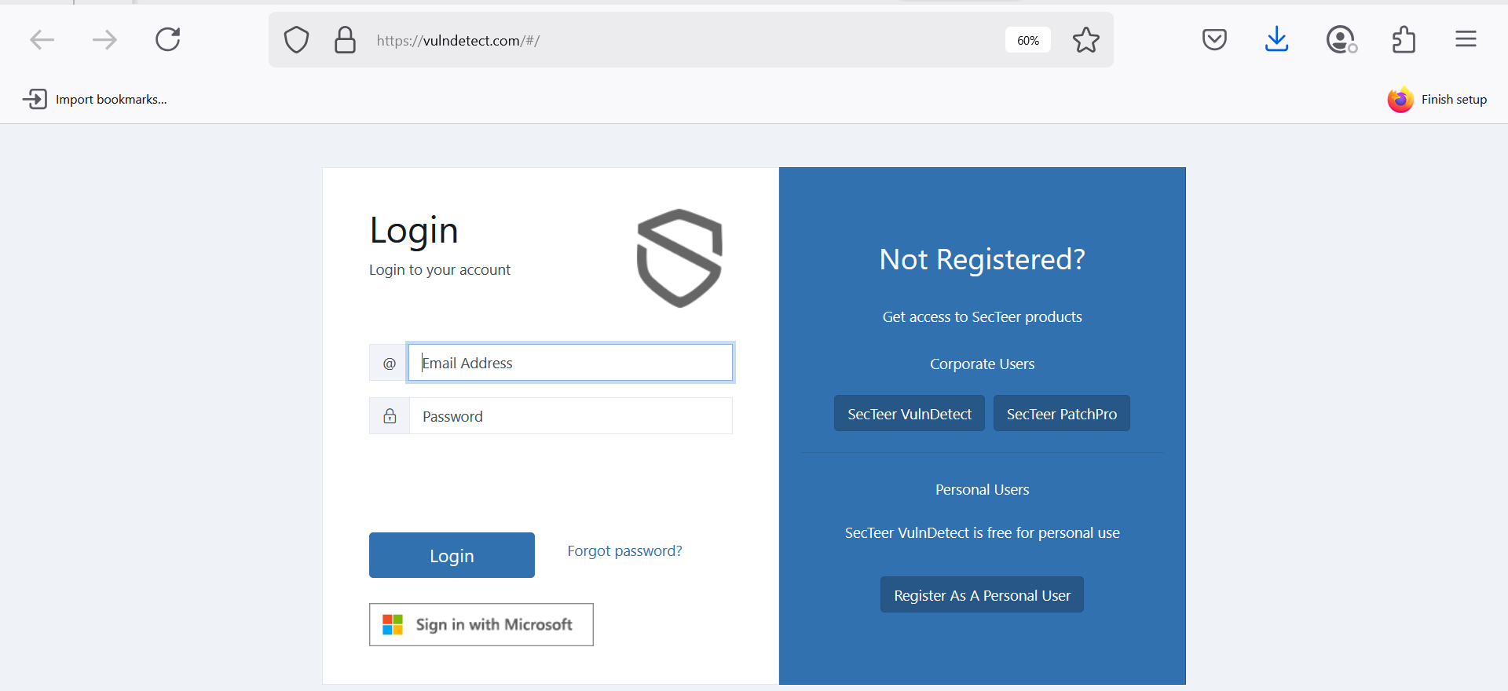
Device Domain
Patch Testing Tools:
VulnDetect (Free for personal use) – Detects outdated software and missing patches.
https://vulndetect.com

Slide 20
Device Domain
Patch Testing Tools:
Secunia PSI (Archived, legacy use only) – For older systems.
Windows Update and Adobe Updater – Built-in patching tools for common software.

Slide 21
Device Domain
Problem-solving: Propose 3 device policies for a Sydney law firm.
(1) Require device encryption, (2) Block unauthorised USB access, (3) Enforce remote wipe for lost/stolen devices.

Slide 22
Device Domain
Debate: Is disabling USBs too harsh in modern workplaces?
Yes: USB bans prevent malware and data leaks. No: It disrupts productivity—controlled access is a better compromise.

Slide 23
LAN Domain
The LAN is like the hallway inside your office building—it connects rooms (devices).
If someone sneaks in here, they can move anywhere quickly.
Example (Australia):
A Queensland university faced LAN attacks due to misconfigured routers.

Slide 24
LAN Domain
Activities:
Discussion: How do misconfigurations lead to breaches?
Misconfigurations (e.g., open ports, weak firewall rules) create exploitable entry points, often overlooked until a breach occurs.

Slide 25
LAN Domain
Hands-on: Simulate LAN security misconfig and fix (Packet Tracer).
Use Cisco Packet Tracer to simulate a LAN with weak settings (e.g., no VLANs, default passwords), then apply fixes like VLAN segmentation and strong admin credentials.

Slide 26
LAN Domain
Problem-solving: Design secure LAN policy for an aged care center.
A secure LAN policy for an aged care center should include (1) role-based access, (2) network segmentation (staff vs. guests), and (3) daily backups with encrypted storage.

Slide 27
LAN Domain
Debate: Are open office Wi-Fi networks ethical?
Yes: It enables community access and transparency. No: Open Wi-Fi compromises privacy and risks data interception.

Slide 28
LAN Domain
Research Q: How common are LAN breaches in Australian SMEs?
LAN breaches in Australian SMEs are frequent due to limited IT budgets and staff, with misconfigurations and weak endpoint controls being top causes (source: ACSC reports).

Slide 29
Private Cloud (WAN) Domain
Your private cloud is like your company’s “secret vault” on the internet.
If routers/firewalls are weak, attackers get inside.
Example (Australia):
A Brisbane company was hacked after router firmware went unpatched.

Slide 30
Private Cloud (WAN) Domain
Activities:
Discussion: Why is patching routers often delayed?
Router patching is often delayed due to fears of downtime, lack of visibility, or forgetting it's needed since routers “just work.”

Slide 31
Private Cloud (WAN) Domain
Hands-on: WAN routing vulnerability hunt (with emulator).
GNS3 (Graphical Network Simulator 3) (Advanced, Real OS images)
Purpose: Emulates real Cisco devices using IOS images (requires a valid Cisco image license).
Safe to Use: Yes, but more complex. Run in isolated virtual environments.
Windows 11 Compatible: Yes
Download: https://www.gns3.com

Slide 32
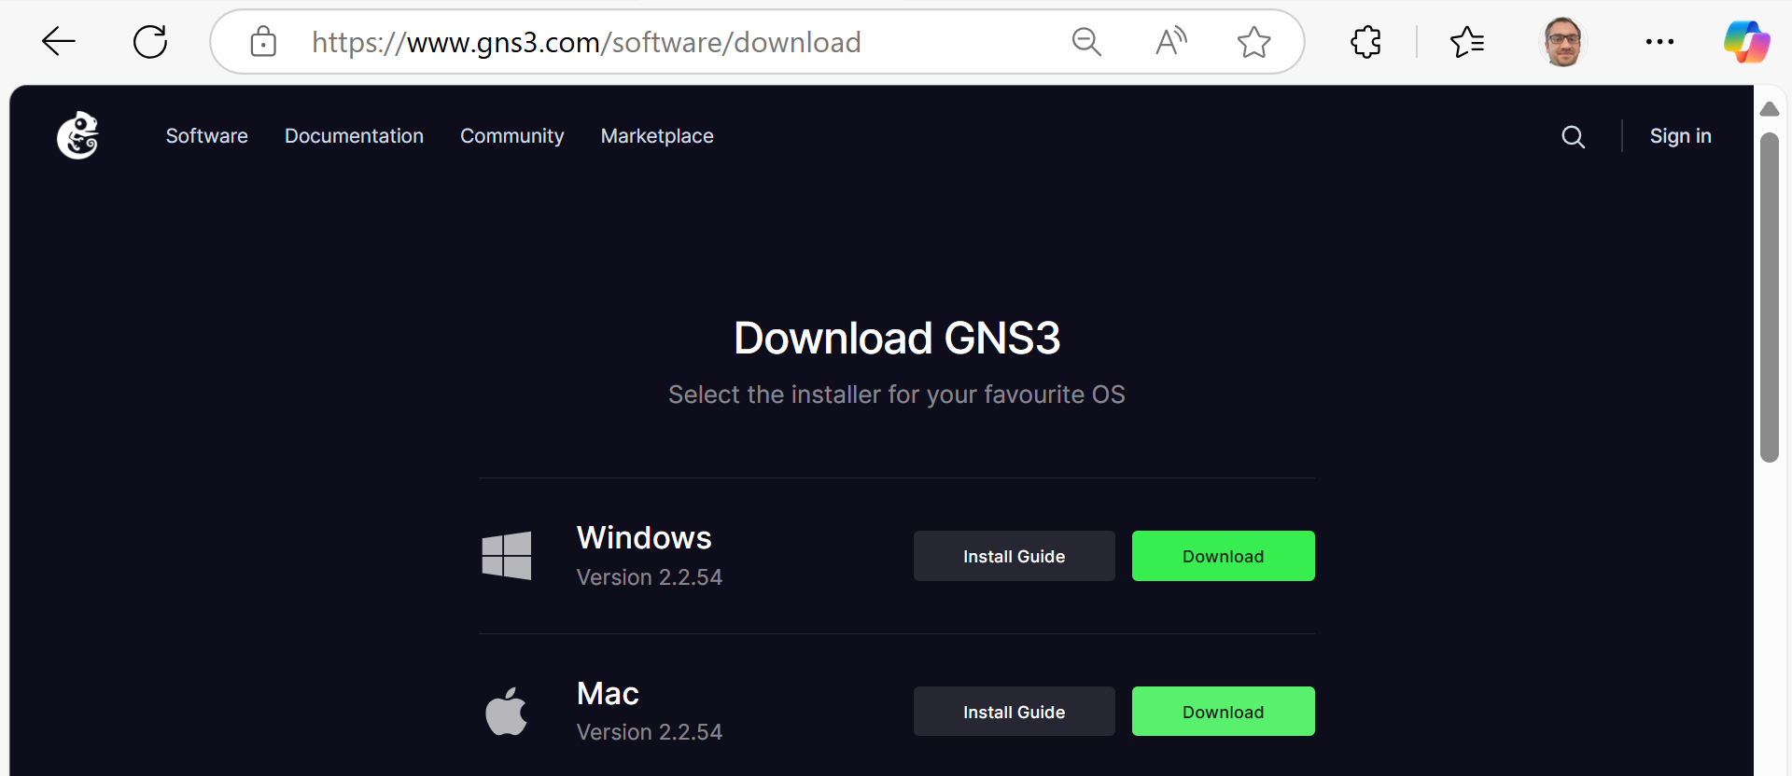
Private Cloud (WAN) Domain

Slide 33
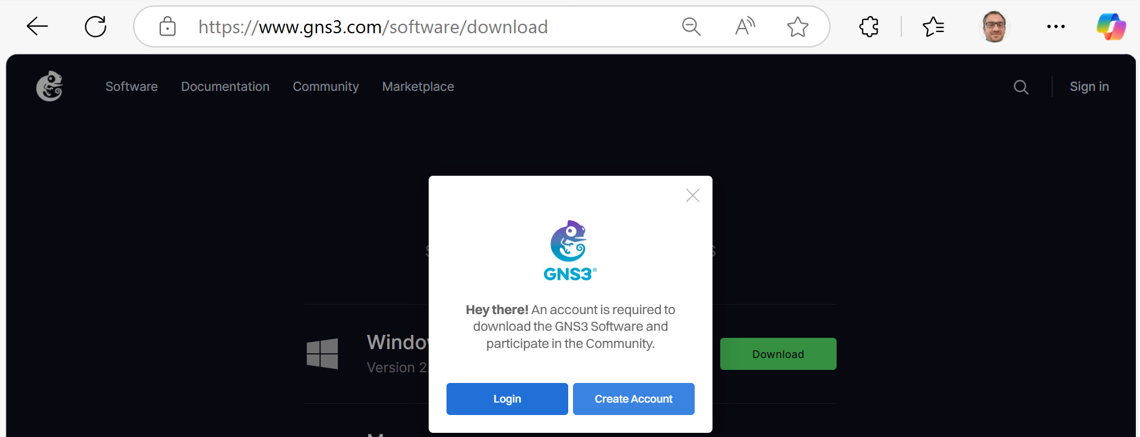
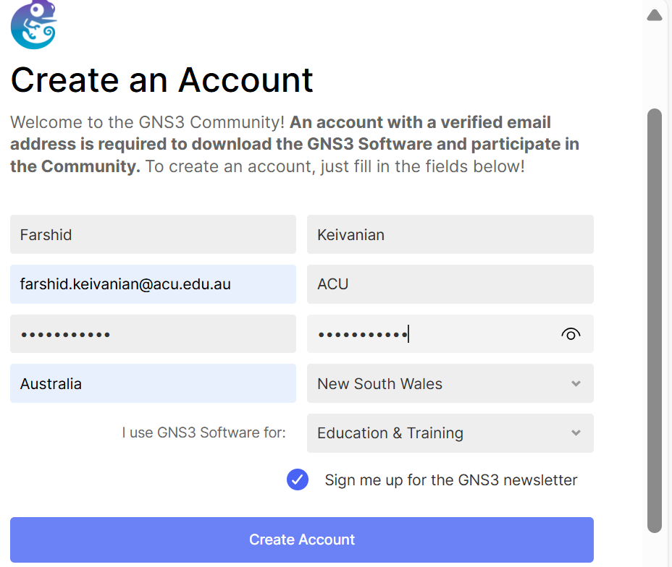
Private Cloud (WAN) Domain

Slide 34
Simulate WAN Router Misconfigurations in GNS3
Step 1: Launch GNS3 & Create a New Project
Open GNS3.
Click “New Project” → Name it (e.g., WAN_Security_Test).

Slide 35
Simulate WAN Router Misconfigurations in GNS3
Step 2: Add a Router to the Workspace
From the Devices panel, drag a router into the workspace. If no routers appear, go to:
Edit > Preferences > Dynamips > IOS Routers
Add a Cisco IOS image (e.g., c7200-adventerprisek9-mz) — requires valid license.

Slide 36
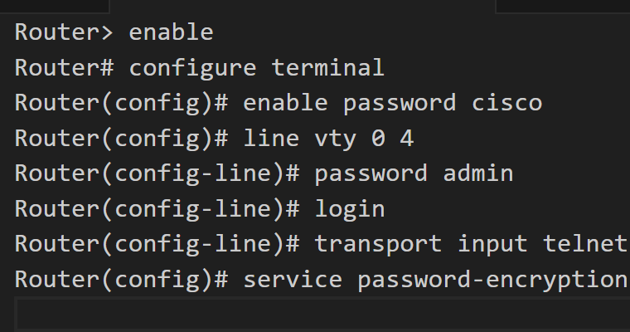
Simulate WAN Router Misconfigurations in GNS3
Step 3: Configure the Router
Right-click router → Console (this opens a terminal).
Use the following commands to simulate misconfigurations:
This setup has issues:
Weak, default-style passwords.
Telnet (insecure) is enabled instead of SSH.

Slide 37
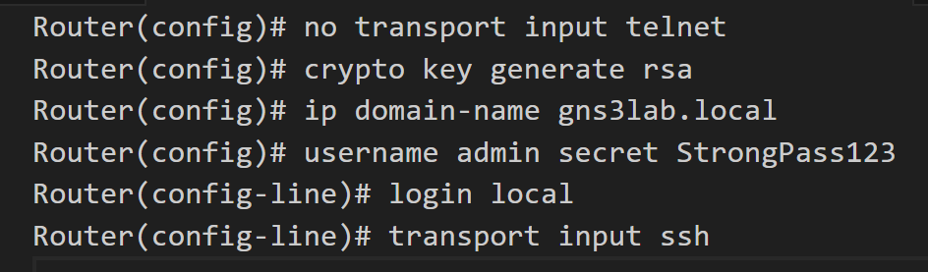
Simulate WAN Router Misconfigurations in GNS3
Step 4: Simulate a Fix
Replace Telnet with SSH:

Slide 38
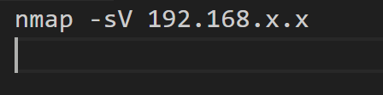
Simulate WAN Router Misconfigurations in GNS3
Step 5: Scan for Open Ports (Optional)
Add a host (e.g., VPCS or a Kali Linux VM) in GNS3.
Connect it to the router.
Use a tool like Nmap (in Kali) to scan for open ports:

Slide 39
Simulate WAN Router Misconfigurations in GNS3
Learning Goals
Identify weak points: telnet access, reused passwords.
Apply security best practices: SSH, strong passwords, user authentication.

Slide 40
Private Cloud (WAN) Domain
Problem-solving: Create a patch checklist for WAN devices.
WAN Patch Checklist: (1) Inventory all WAN devices, (2) Check vendor firmware updates monthly, (3) Test before deployment, (4) Schedule patch during low-traffic hours, (5) Log update completion.

Slide 41
Private Cloud (WAN) Domain
Debate: Should remote users be fully trusted?
No: Remote users pose risks without controls (e.g., unsecured devices, home Wi-Fi). Yes: With proper endpoint security and monitoring, trust can be conditional.

Slide 42
Private Cloud (WAN) Domain
Research Q: How are Australian enterprises protecting remote cloud infrastructure?
Australian enterprises use Zero Trust, cloud access security brokers (CASBs), MFA, encryption, and continuous monitoring to protect remote cloud systems (per ACSC guidance).

Slide 43
Public Cloud Domain
Think of public cloud like renting a storage locker (e.g., AWS, Azure).
If your lock is weak (bad passwords), others may get in.
Example (Australia):
An Adelaide startup’s AWS data was breached due to misconfigured identity access.

Slide 44
Public Cloud Domain
Activities:
Discussion: What are risks of using shared cloud?
Shared cloud risks include data leakage, misconfigured access controls, and insecure APIs across tenants.

Slide 45
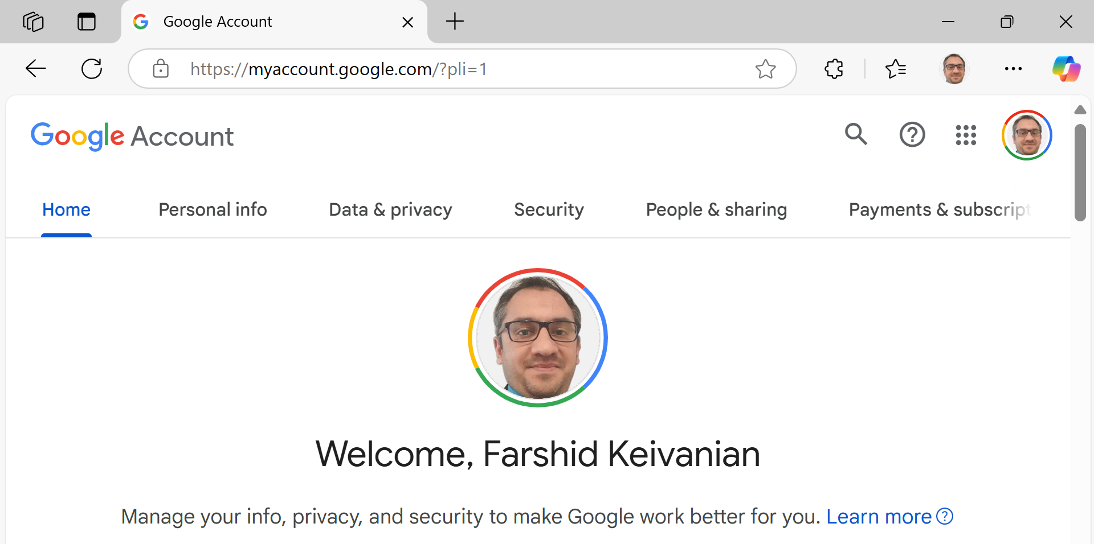
Public Cloud Domain
Hands-on: Role-play setting MFA in Google Cloud/Azure portal.
For Users:
Log into https://myaccount.google.com

Slide 46
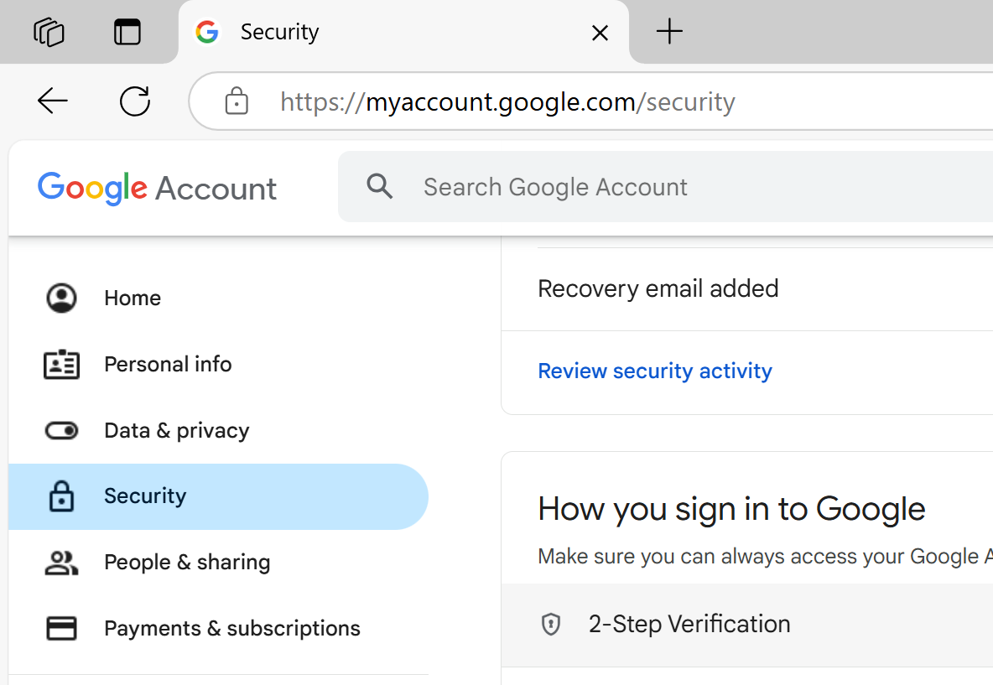
Public Cloud Domain
Go to Security > 2-Step Verification.

Slide 47
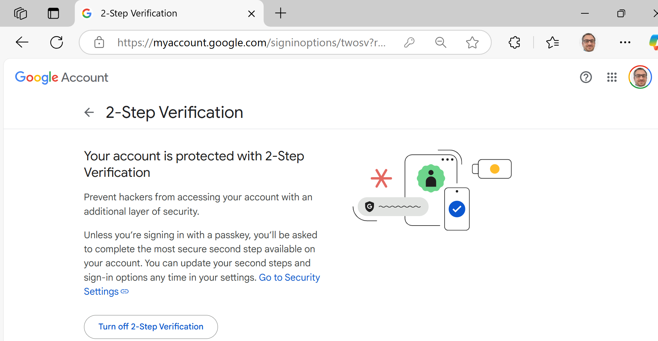
Public Cloud Domain
Click Get Started.
Enter password again.
Choose method: Phone prompt, Authenticator App, or SMS code.
Follow on-screen steps to finish setup.

Slide 48
Public Cloud Domain
For Admins (via Google Workspace):
Go to: https://admin.google.com
Sign in as admin.
Navigate: Security > Authentication > 2-step verification.
Click “Allow users to turn on 2-step verification” → Save.
Optionally enforce MFA for all users:
Go to Users > Select user/group.
Click Security tab → Turn on enforcement for 2-step verification.

Slide 49
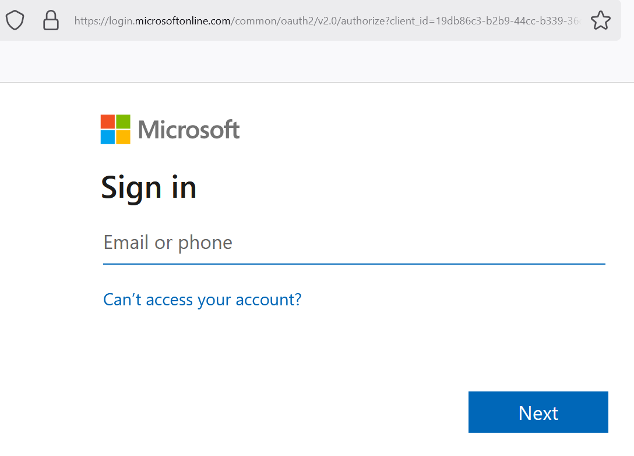
Public Cloud Domain
Microsoft Azure Portal – Enabling MFA
For Users:
Sign in at: https://aka.ms/mfasetup

Slide 50
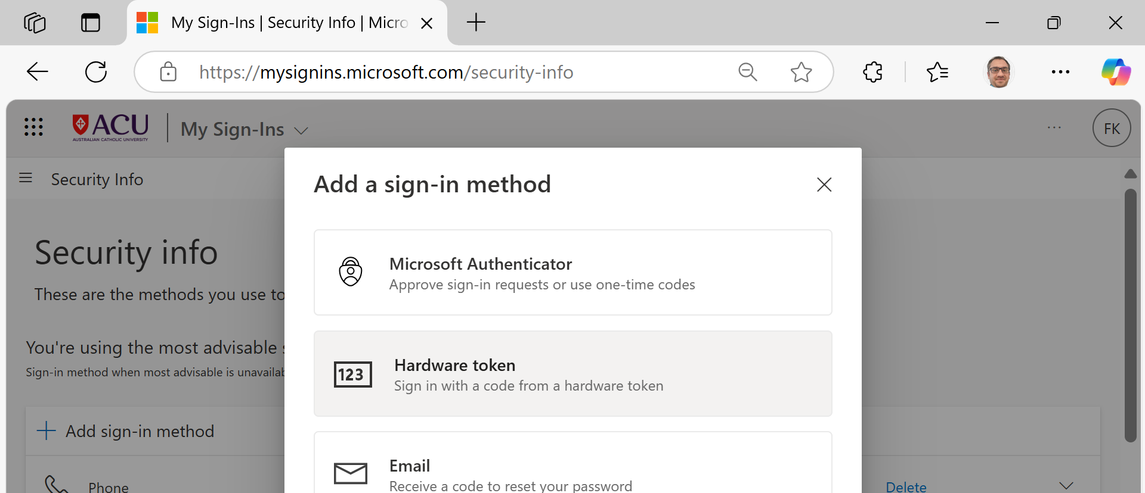
Public Cloud Domain
Microsoft Azure Portal – Enabling MFA
You’ll be prompted to set up MFA.

Slide 51
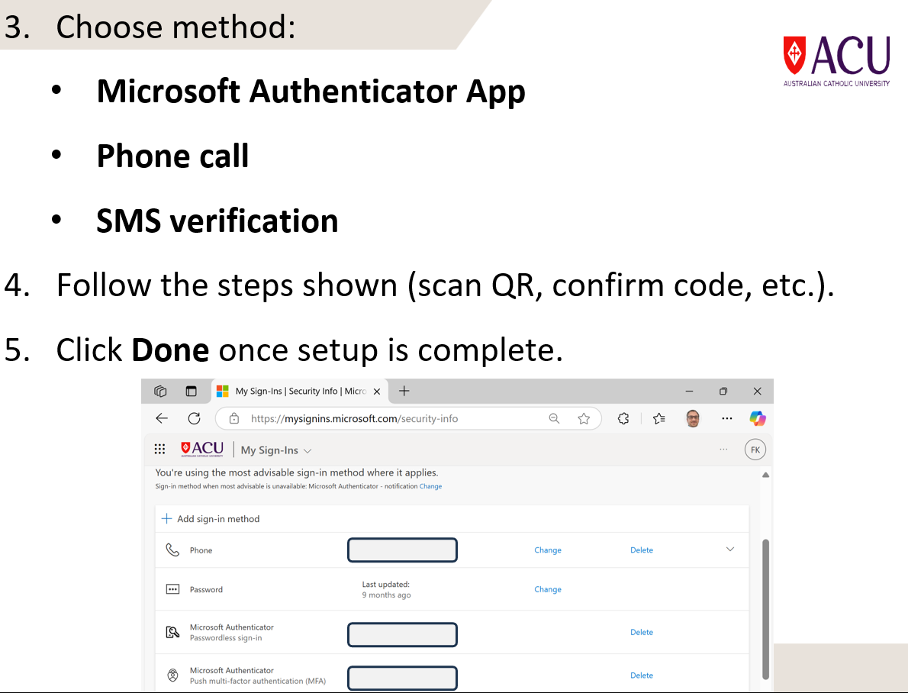

Slide 52
For Admins:
Go to: https://portal.azure.com
Navigate: Azure Active Directory > Users.
Click Multi-Factor Authentication (at the top menu).
Find the user → Click Enable.
User status changes to “Enabled.”

Slide 53
Public Cloud Domain
Problem-solving: Draft cloud access policies for a Melbourne startup.
Policy draft: (1) Enforce MFA, (2) Restrict access by role/location, (3) Log and review access weekly.

Slide 54
Public Cloud Domain
Debate: Is public cloud truly secure?
Yes: Top providers offer strong encryption and compliance. No: Users still misconfigure settings, leading to breaches.

Slide 55
Public Cloud Domain
Research Q: Compare AWS and Azure compliance with Australian privacy laws.
AWS and Azure both comply with Australian Privacy Principles (APPs) and offer data residency options in Australia; Azure has local certifications like IRAP.

Slide 56
Physical Facilities Domain
All your fancy digital security fails if someone walks into your server room!
Threats include weather, unlocked doors, and tailgating.
Example (Australia):
A Canberra company lost 48 hours of service during bushfires—no physical backup location.

Slide 57
Physical Facilities Domain
Activities:
Discussion: Why do orgs neglect physical security?
Physical security is often neglected due to overreliance on digital controls, budget limits, or lack of awareness.

Slide 58
Physical Facilities Domain
Hands-on: Security audit of your building/classroom entry system.
Inspect door locks, access card readers, CCTV presence, visitor logs—note gaps or weaknesses in entry control.

Slide 59
Physical Facilities Domain
Problem-solving: Build an emergency plan for a Sydney office tower.
Emergency plan should include evacuation routes, fire/smoke sensors, emergency contacts, access control override, and backup power protocols.

Slide 60
Physical Facilities Domain
Debate: Should physical and cyber security be managed by one team?
Yes: Unified teams ensure integrated threat response. No: Each requires specialised expertise—separate teams may work better with coordination.

Slide 61
Physical Facilities Domain
Research Q: How do Australian companies secure server rooms physically?
Australian companies use keycard access, 24/7 CCTV, biometric locks, and restricted personnel lists to secure server rooms, aligned with ISO/IEC 27001 and ACSC guidance.

Slide 62
Application Domain
Applications (software systems) are your tools; if broken, the job stops.
Downtime, data loss, and bugs can crash critical systems.
Example (Australia):
An online retail system in Perth crashed during EOFY sale due to poor software testing.

Slide 63
Application Domain
Problem-solving: Plan backup and failover for a banking system.
Design includes real-time backups, offsite replication, automated failover to secondary systems, and disaster recovery testing.

Slide 64
Understanding the Ethics of Working in Cybersecurity

Slide 65
Ethics and Guiding Principles
Ethics = Your Inner Compass Imagine you're a lifeguard. You could technically check your phone while watching the pool, but ethically, you shouldn't. Similarly, cybersecurity specialists must do what's right, even if the law doesn't say “no.”
Analogy:
A cybersecurity specialist is like a bank vault manager — trusted with immense responsibility and expected to act ethically beyond legal compliance.

Slide 66
Ethics and Guiding Principles
Australian Example:
The OAIC (Office of the Australian Information Commissioner) enforces ethical handling of data under the Privacy Act 1988.

Slide 67
Ethics and Guiding Principles
Activities:
Problem-solving: You find sensitive info accidentally left open. What’s the ethical response?
Ethically, report it immediately to the appropriate authority (e.g., IT/security team), avoid accessing or sharing the information.

Slide 68
Cyber Laws and Liability
Cyber laws = Digital Rules of the Road Laws tell us what not to do online—like don’t steal, don’t hack. But tech moves faster than the law. That’s where gaps happen.
Analogy:
Imagine roads with self-driving cars but no traffic laws yet. That’s what modern cyberspace can feel like.
Australian Example:
Australia’s Criminal Code Act 1995 includes offences for hacking, malware, and unauthorized access.

Slide 69
Cyber Laws and Liability
Activities:
Debate: “The law should always evolve faster than the technology.”
Yes: Proactive laws prevent misuse. No: Rushed laws risk overreach or stifling innovation—balance is key.

Slide 70
Cyber Laws and Liability
Activities:
Research Q: How does Australia prosecute cybercrime compared to the US?
Australia uses federal criminal law with ACSC support, focusing on deterrence and recovery; the US often applies state-level laws with stronger penalties and more cybercrime task forces.

Slide 71
U.S. Cyber Laws & International Laws
Different Countries, Different Cyber Laws Each country has its own “rulebook.” In the US, there are multiple sector-specific laws (e.g., HIPAA, GLBA). Globally, countries agree on treaties like the Convention on Cybercrime.
Analogy:
Cyber laws are like international travel rules. Your Australian driver’s license might not work in Europe without adjustments.

Slide 72
U.S. Cyber Laws & International Laws
Problem-solving: You're advising a multinational company – what laws must they follow in both Australia and the US?
A multinational must follow Australia’s Privacy Act 1988 (APPs) and relevant US laws like CCPA, HIPAA, and FTC rules, based on user location, data type, and industry, ensuring proper data handling and breach notifications in both countries.

Slide 73
Cybersecurity Information Websites
Staying Updated = Staying Safe These websites are like "weather forecasts" for cyber threats. They warn us about current vulnerabilities.
Analogy:
Just like Australians check bushfire alerts, cybersecurity teams check websites like NVD and ACSC for threat updates.
Australian Example:
The Australian Cyber Security Centre (ACSC) gives daily alerts to Australian businesses.

Slide 74
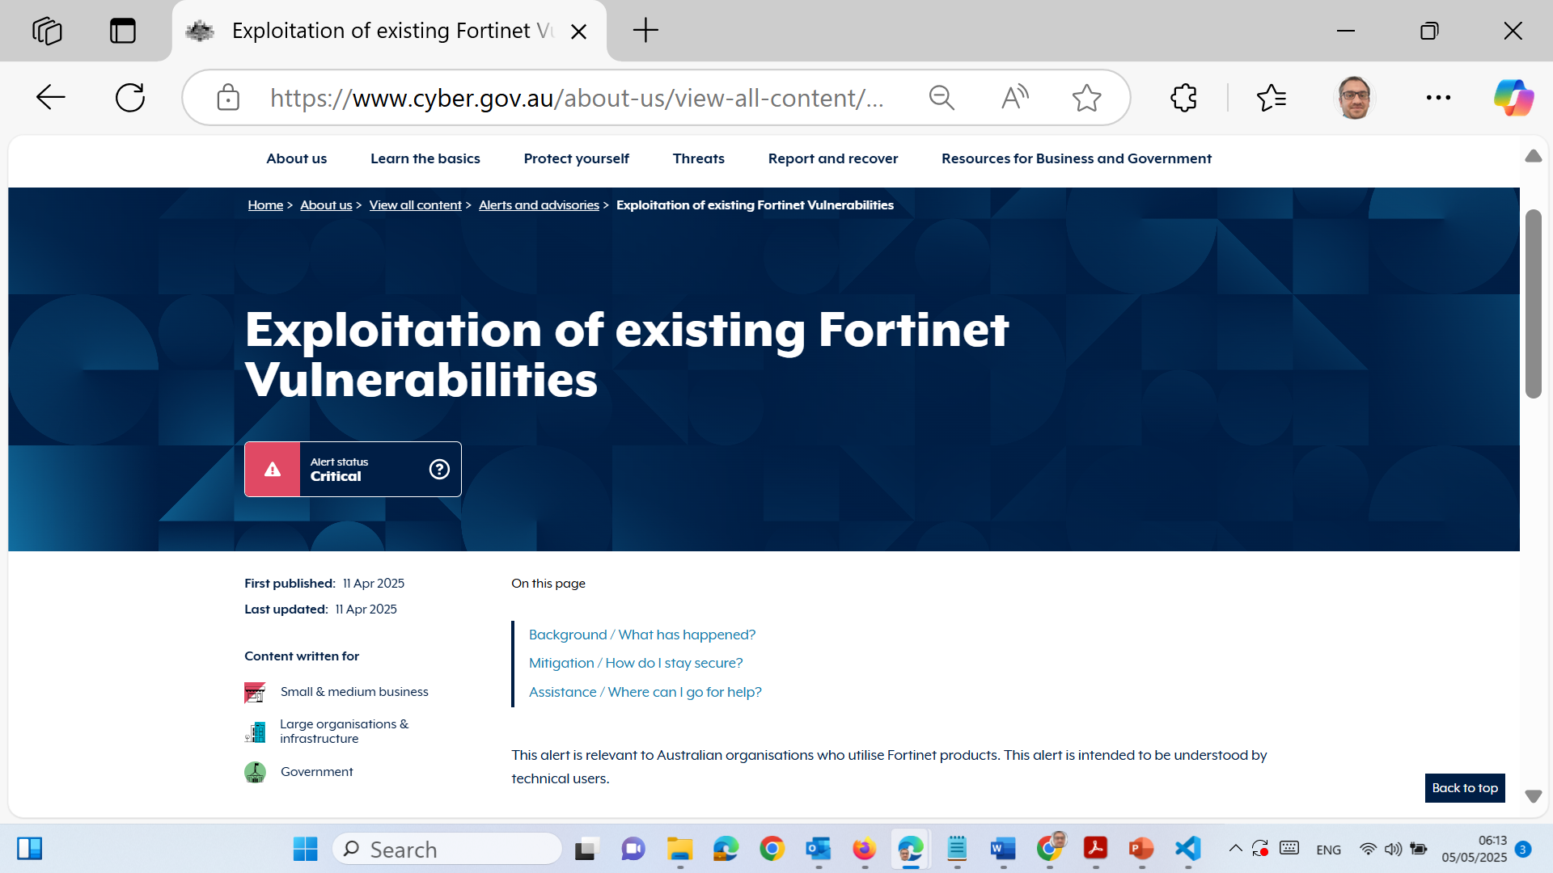
Cybersecurity Information Websites
Activities:
Hands-on: Visit https://www.cyber.gov.au and summarize one current alert.

Slide 75
What happened? Fortinet devices are being actively exploited due to unpatched or previously compromised vulnerabilities in their SSL VPN services.
How to stay secure?
Update to the latest firmware.
Check configurations for tampering.
Monitor networks for suspicious activity.
Follow Fortinet’s official guidance.
Need help? Contact 1300 CYBER1 or email asd.assist@defence.gov.au.

Slide 76
Cybersecurity Weapons
Cybersecurity Tools = Digital Defence Gear Vulnerability scanners, pen testers, and sniffers are like tools a locksmith or burglar might use—depending on intent.
Analogy:
Imagine a firefighter with a thermal camera to detect heat spots—cybersecurity tools do the same but for network weaknesses.
Australian Example:
The ACSC encourages penetration testing annually for critical infrastructure firms (banks, utilities).

Slide 77
Cybersecurity Weapons
Comparison Table:
Tool | Purpose | Analogy
Vulnerability Scanner | Finds weak points | Like a safety inspector
Pen Test | Simulated attack | Like a hacker with permission
Packet Sniffer | Monitors traffic | Like CCTV for your data
Security Tools | Mixed utilities | Like a Swiss Army knife

Slide 78
Next Step

Slide 79
Exploring the Cybersecurity Profession
“Cybersecurity = Team Sport” Cybersecurity is not a one-person job. According to ISO 27000, it needs a whole team — from senior managers to HR to network architects. Everyone has a part in defending data.

Slide 80
Exploring the Cybersecurity Profession
Analogy:
Think of a cybersecurity team like an airport security system:
Senior manager = Airport director
Security pros = Guards & CCTV operators
HR = Staff training & response unit
Network architects = The system designers behind the scenes

Slide 81
Exploring the Cybersecurity Profession
Australian Example:
In Australia, roles like Cyber Security Analyst, SOC Analyst, and IT Risk Manager are in demand on sites like Seek.com.au and the Australian Government APS Jobs portal.

Slide 82
Exploring the Cybersecurity Profession
Job Search Tool Comparison:
Platform | Best For
Seek.com.au | General IT and cybersecurity jobs
APSJobs.gov.au | Government & defence cybersecurity roles
LinkedIn Jobs | Professional networking & job matching

Slide 83
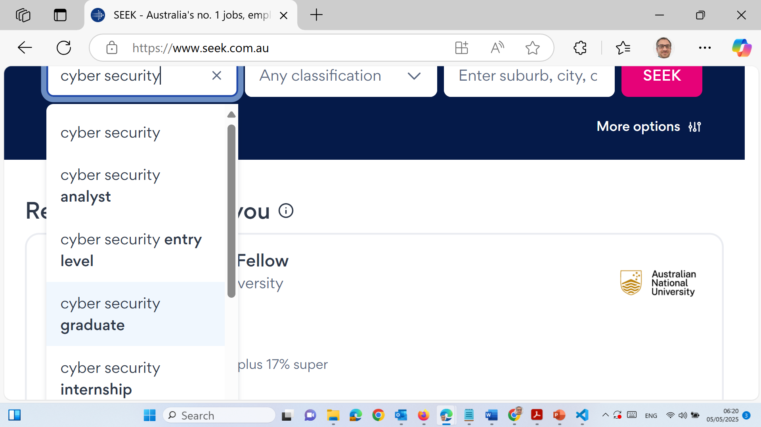
Exploring the Cybersecurity Profession
Hands-on: Visit Seek.com.au and identify 3 cybersecurity job ads. List job titles, required skills, and salary range.

Slide 84
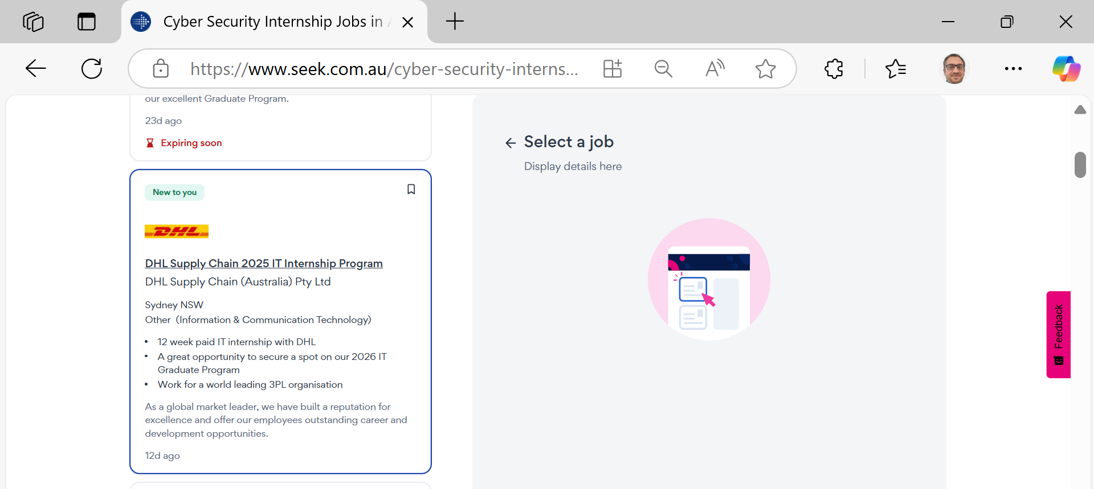
Exploring the Cybersecurity Profession
Hands-on: Visit Seek.com.au and identify 3 cybersecurity job ads. List job titles, required skills, and salary range.

Slide 85
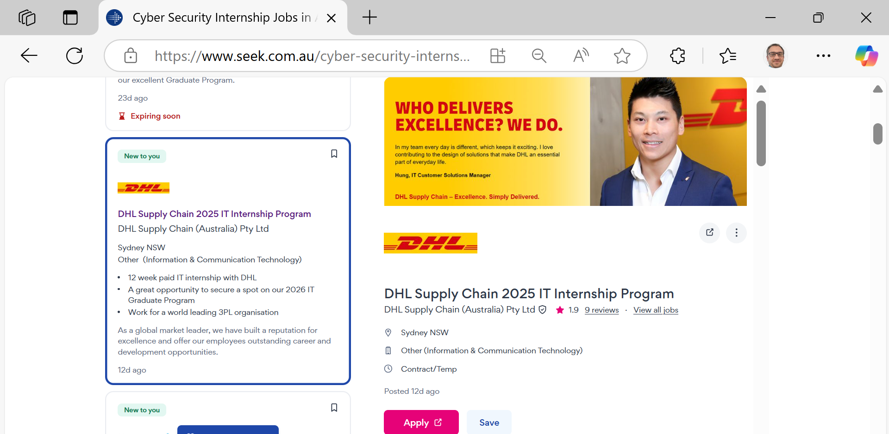
Exploring the Cybersecurity Profession
Hands-on: Visit Seek.com.au and identify 3 cybersecurity job ads. List job titles, required skills, and salary range.

Slide 86
Summary
This session tied everything together — domains of cybersecurity, laws, ethical issues, and how to join the profession.
Analogy:
Like a puzzle, each topic is a piece. When you put them together — laws, ethics, tools, roles — you get the full picture of a secure digital world.

Slide 87

Next Week
We will study
Legal, Privacy & Ethical Issues

Slide 88

Questions?

